Slide 1
UTILITY BILLING SYSTEM
A comprehensive platform that manages the entire lifecycle of utility services—from consumer registration and meter reading to bill generation and payment processing. It's the digital backbone connecting utility providers with millions of consumers.
Problem Statement:
Manual utility billing systems are error-prone, inefficient, and difficult to scale. A secure and automated system is required to manage multiple utilities, users, and payments in a transparent and efficient manner.
Objectives of the Project:
Centralize utility billing management
Automate billing and payments
Provide secure, role-based access
Improve transparency and efficiency
Support scalability using microservices
System Users & Roles:
Admin
Manage users, utility types, tariff plans, and billing cycles
Billing Officer
Meter readings & bill generation
Accounts Officer
Track Payments and Outstanding balances
Consumer
View bills, make payments, track consumption

Slide 2
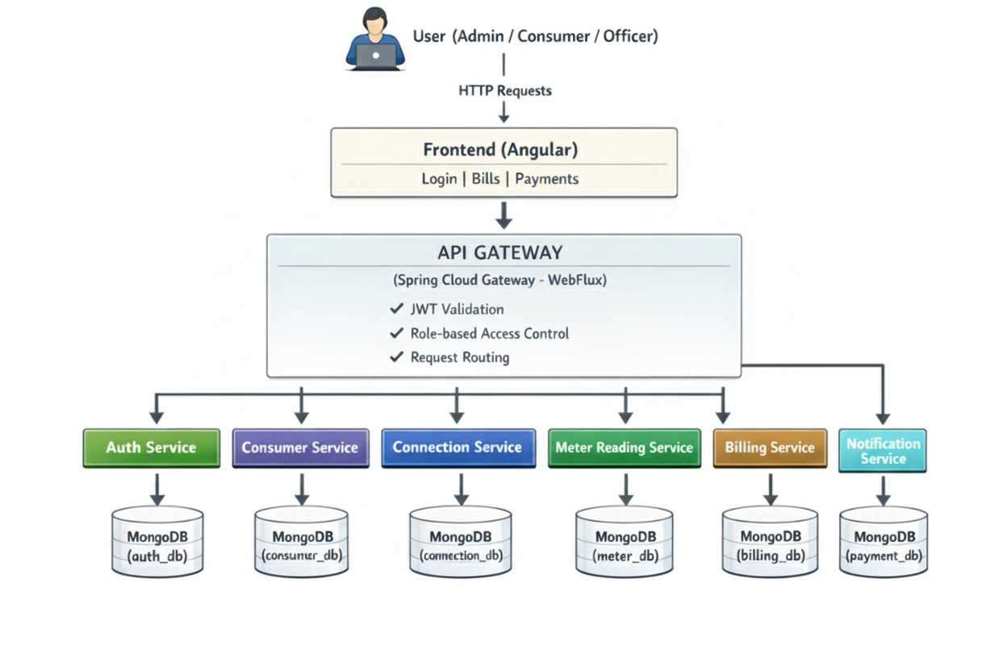
Micro-Services Architecture Overview

Slide 3
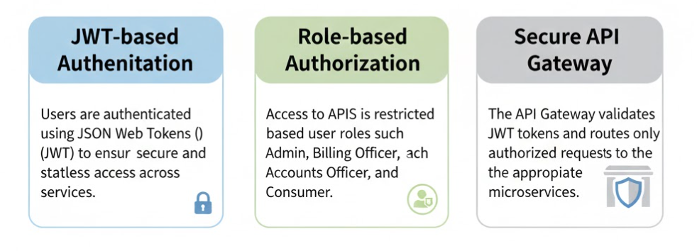
Technology Stack
Frontend: Angular
Backend: Spring Boot (WebFlux)
Database: MongoDB
Security: JWT Authentication
Messaging: Kafka
Service Discovery: Eureka
Configuration: Spring Cloud Config
Deployment: Docker
Security Implementation

Slide 4
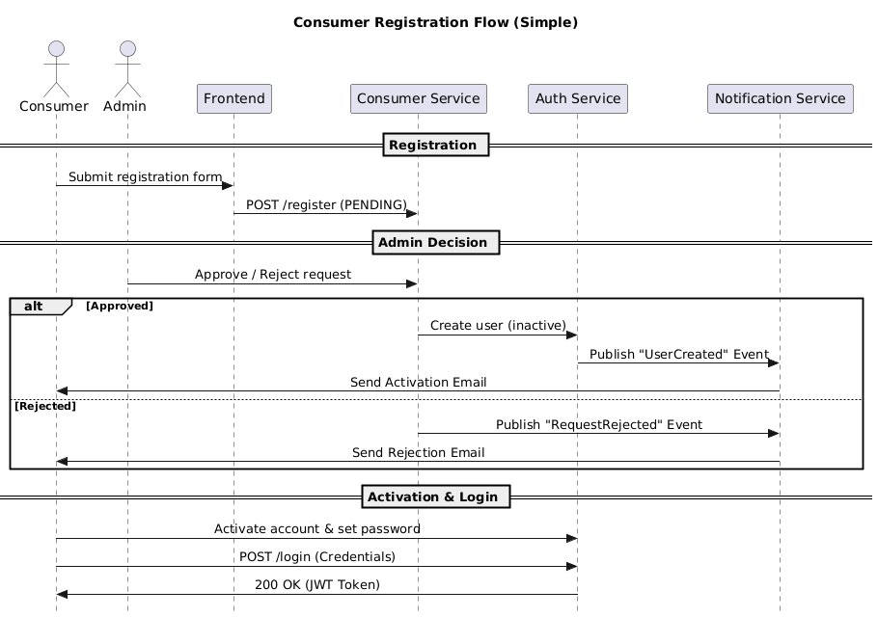
REGISTER – Sequence Diagram

Slide 5
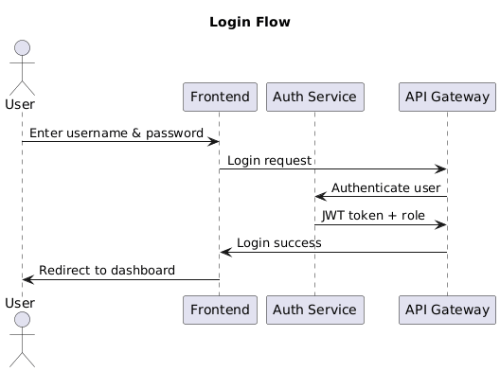
LOGIN – Sequence Diagram

Slide 6
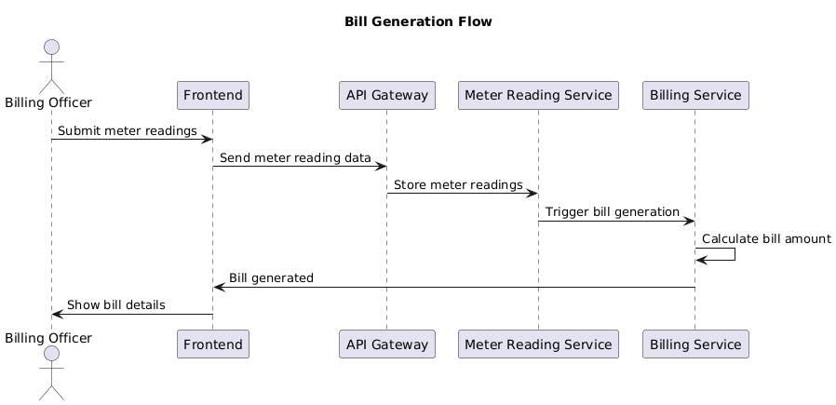
BILL GENERATION – Sequence Diagram

Slide 7
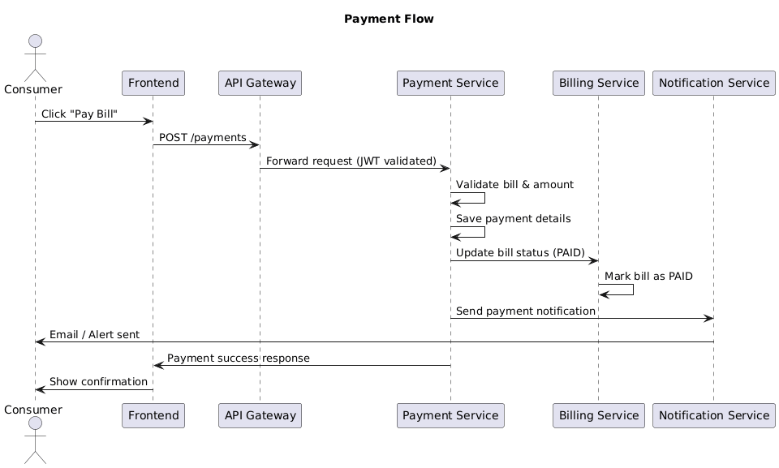
PAYMENT – Sequence Diagram

Slide 8
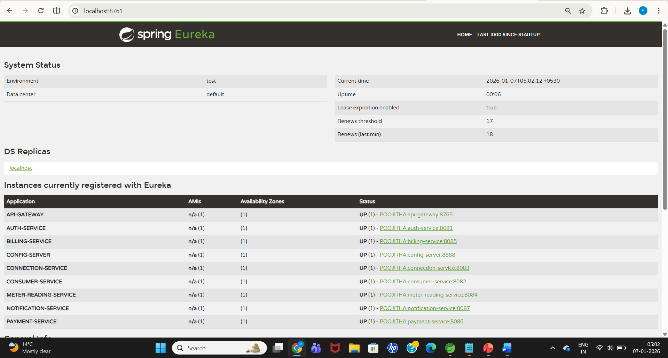
Implementation Screenshots
Eureka:

Slide 9
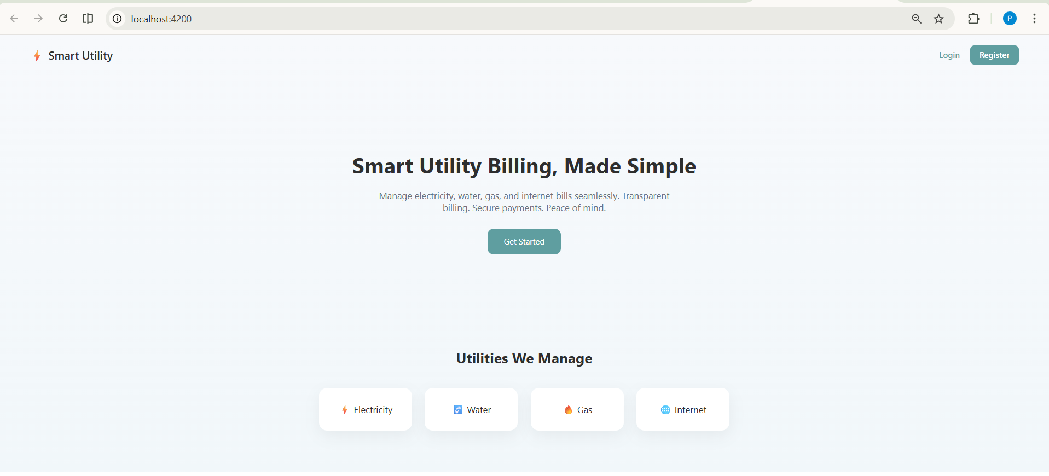
Home Page

Slide 10
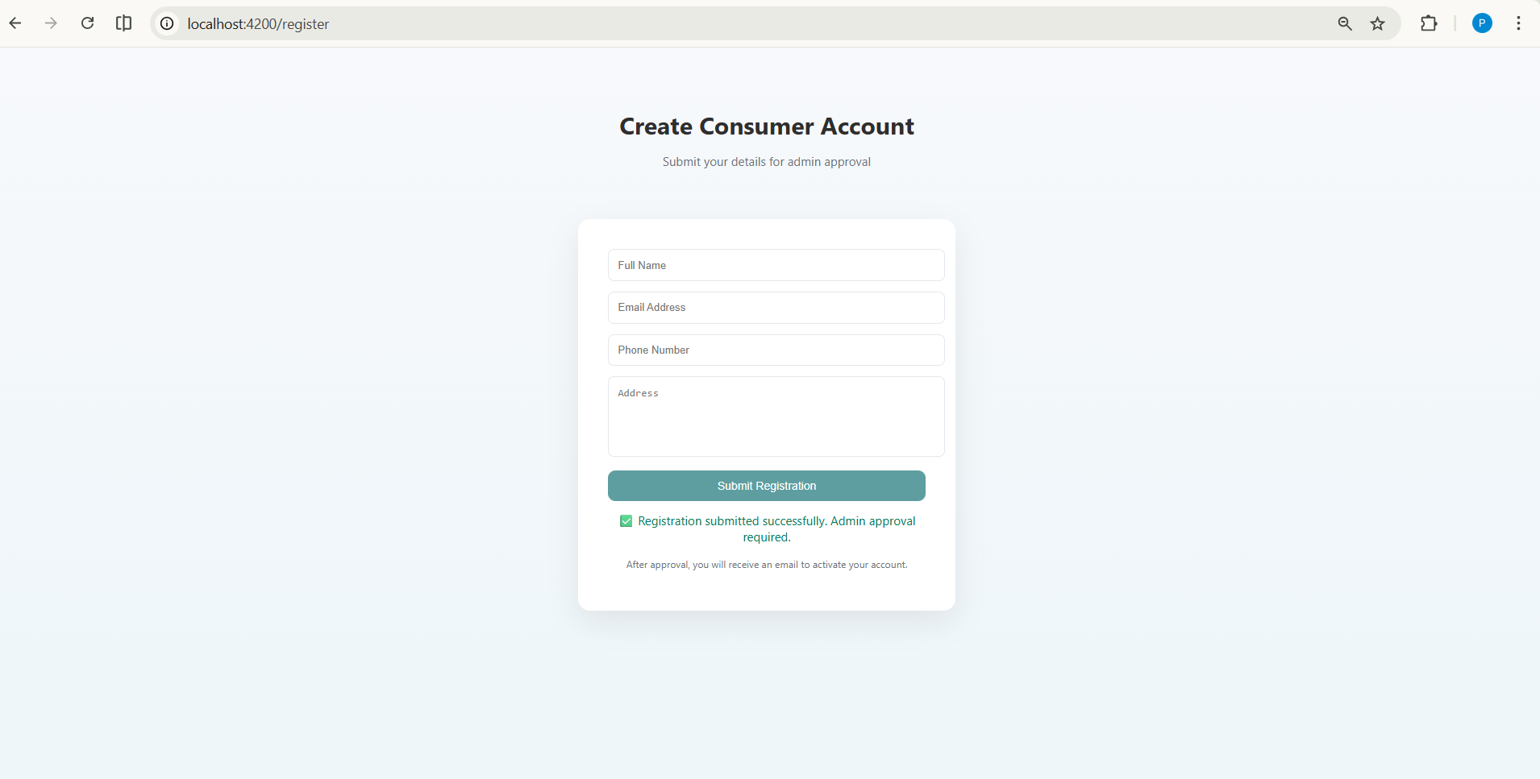
After consumer send a register

Slide 11
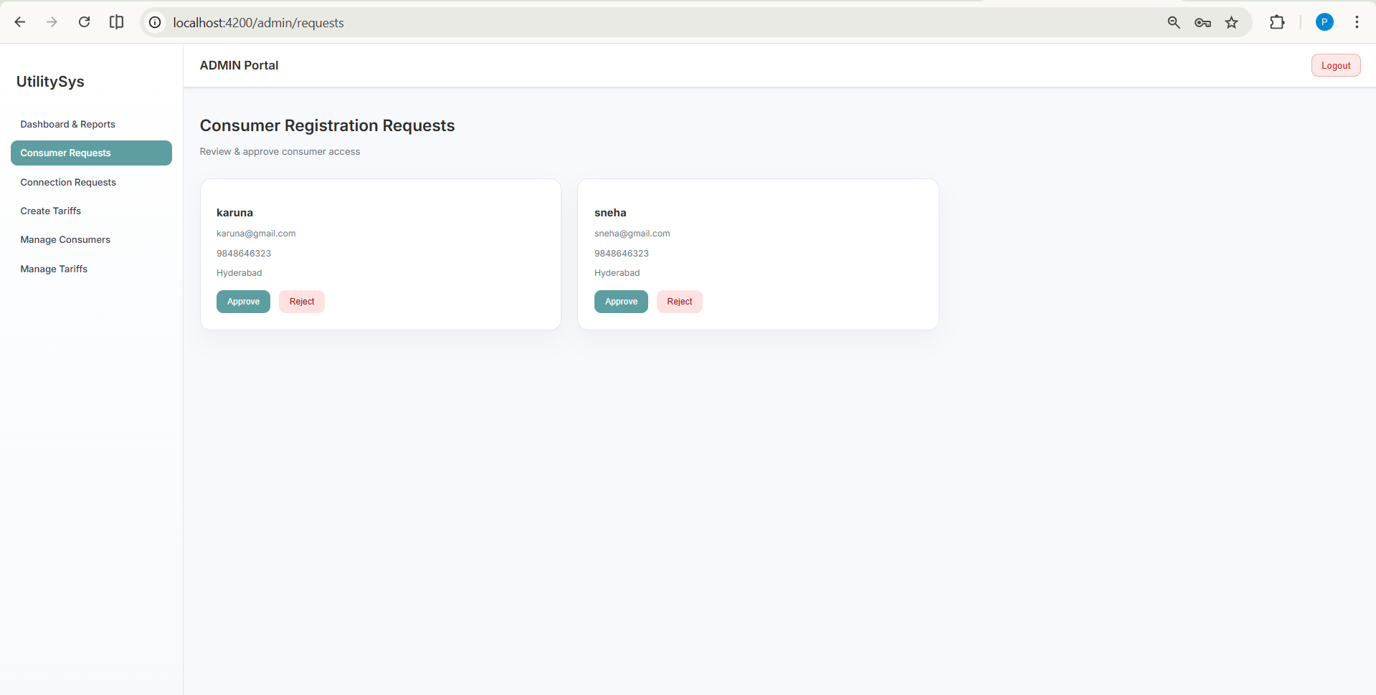
In ADMIN portal, it shows the requests to be approved or rejected

Slide 12
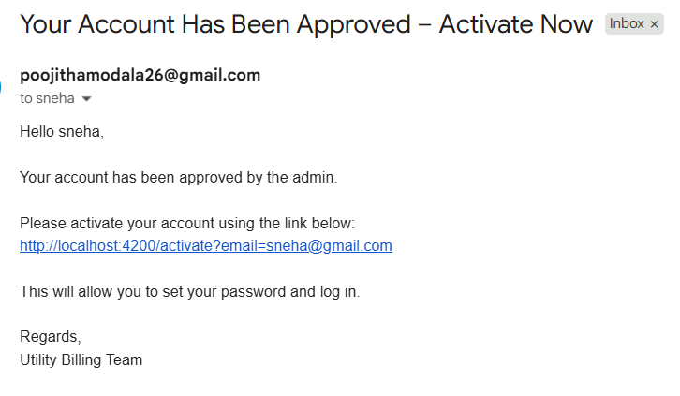
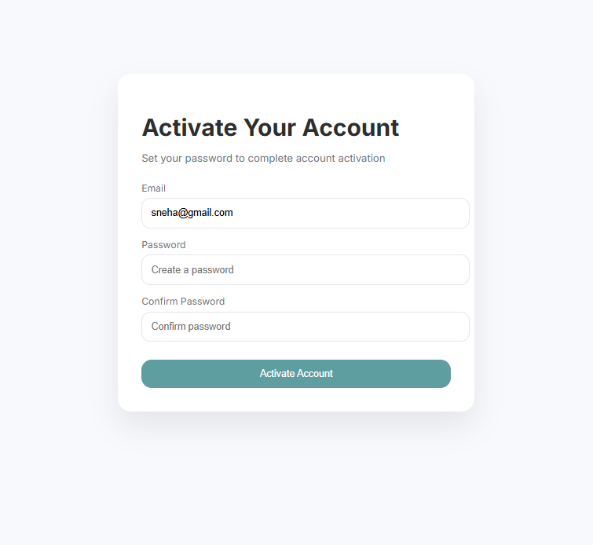
The user will get an activation link to set password

Slide 13
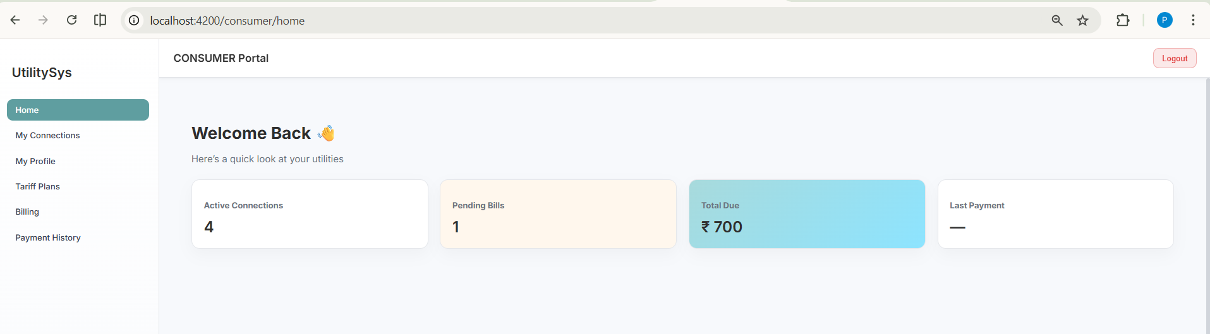
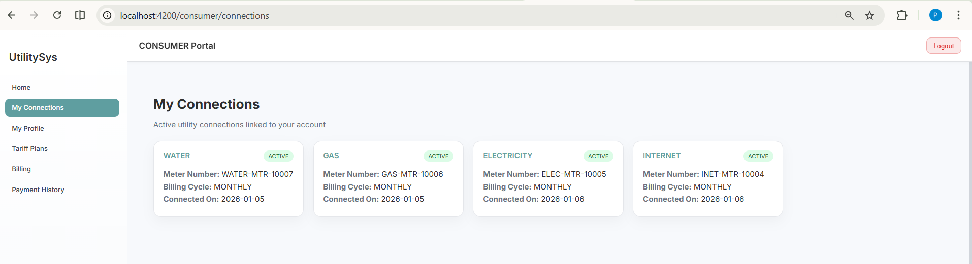
Consumer Home
All utility connections of Consumer

Slide 14
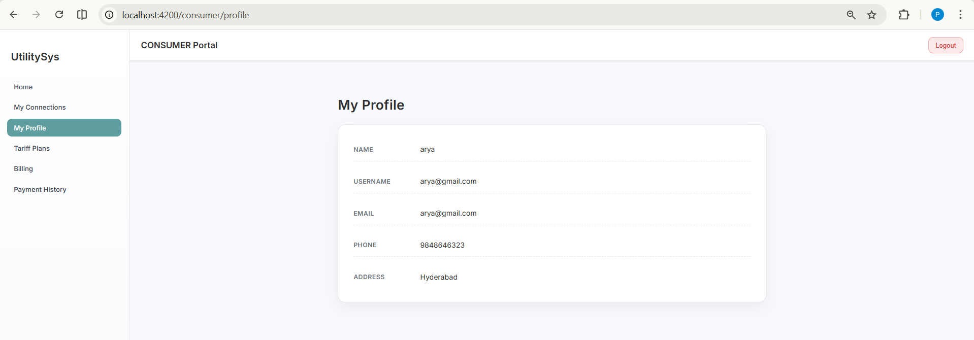
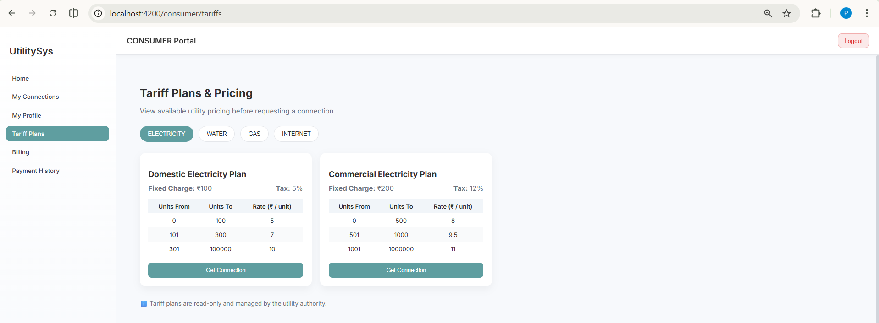
Consumer profile
All existing Tariff plans are shown to Consumer for each utility, Consumer can request for a connection if not there in this page

Slide 15
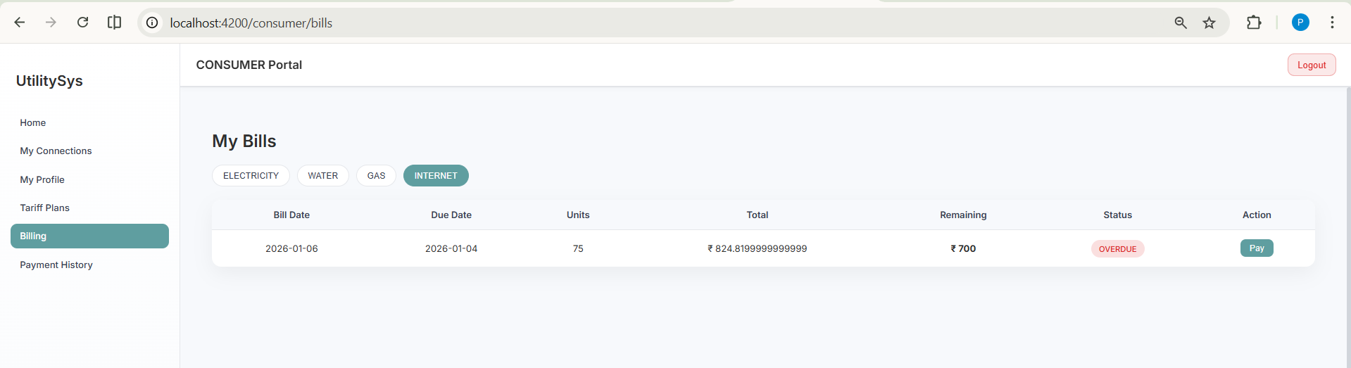
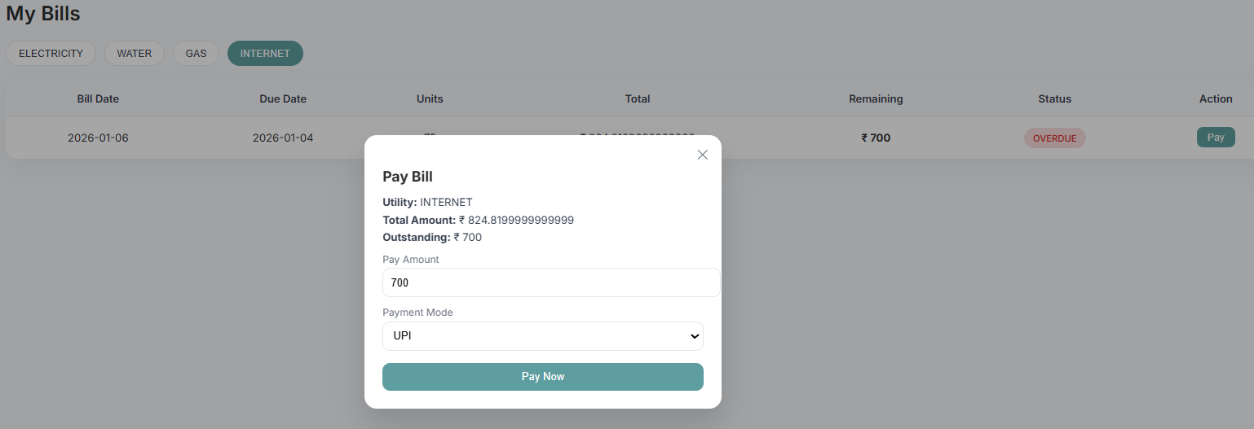
Bills for each utilty
Payment of bills

Slide 16
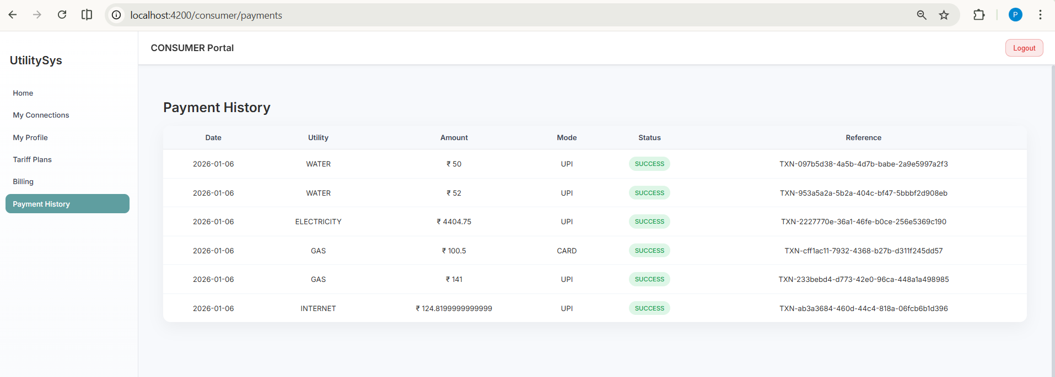
Payment History of Consumer

Slide 17
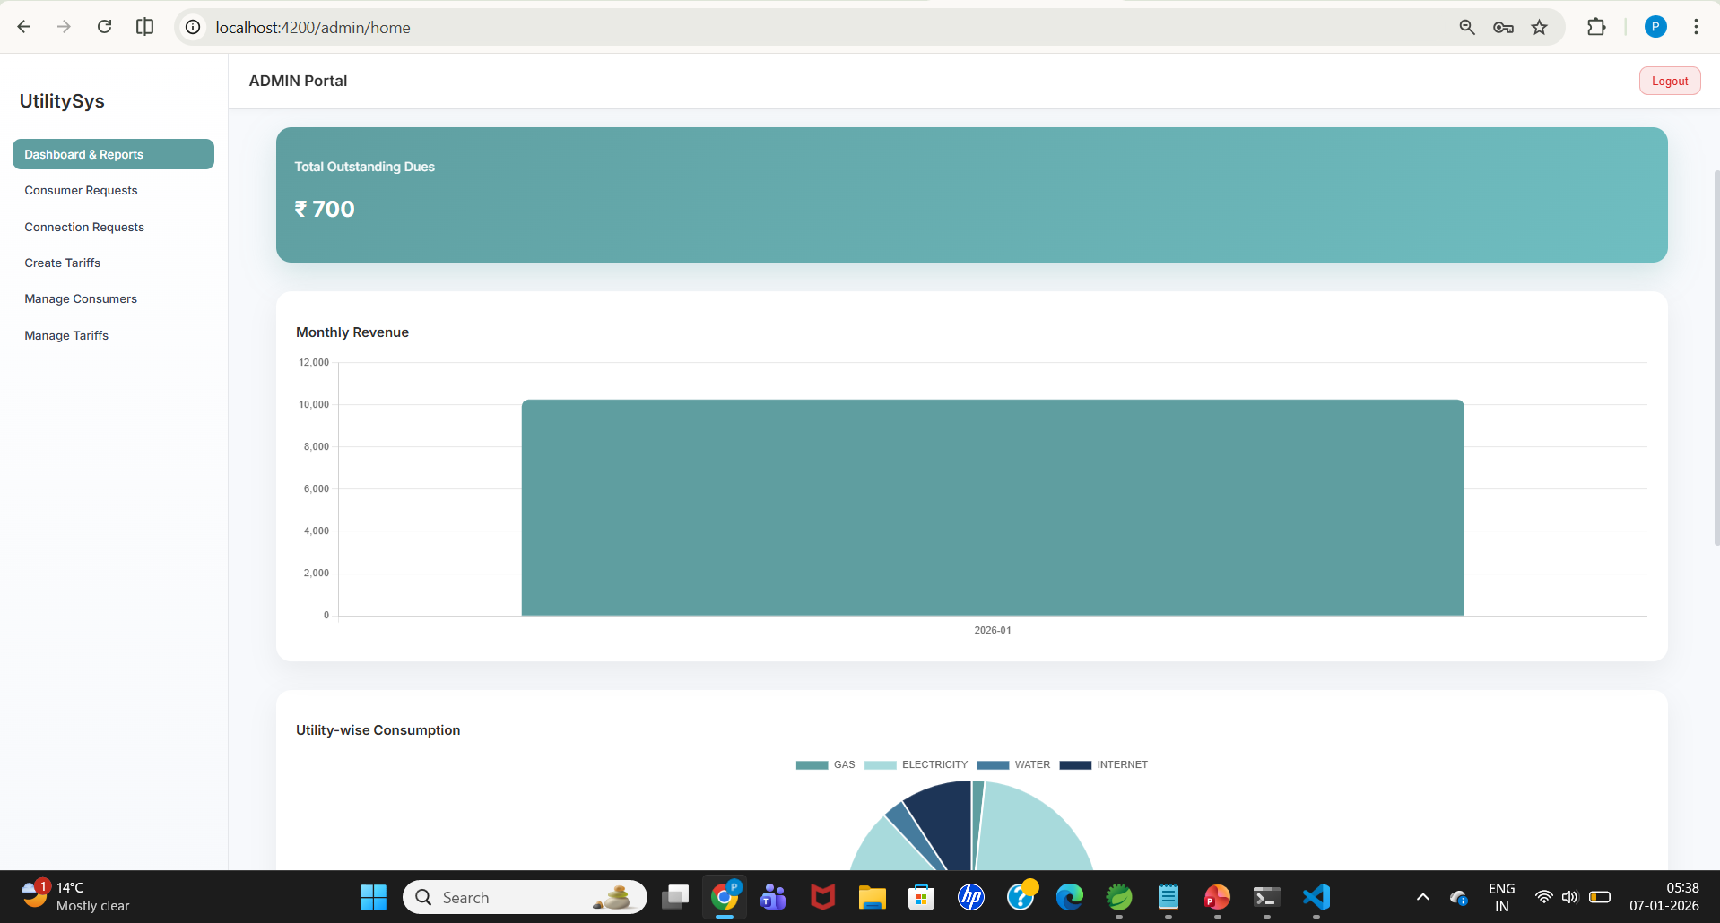
ADMIN Home

Slide 18
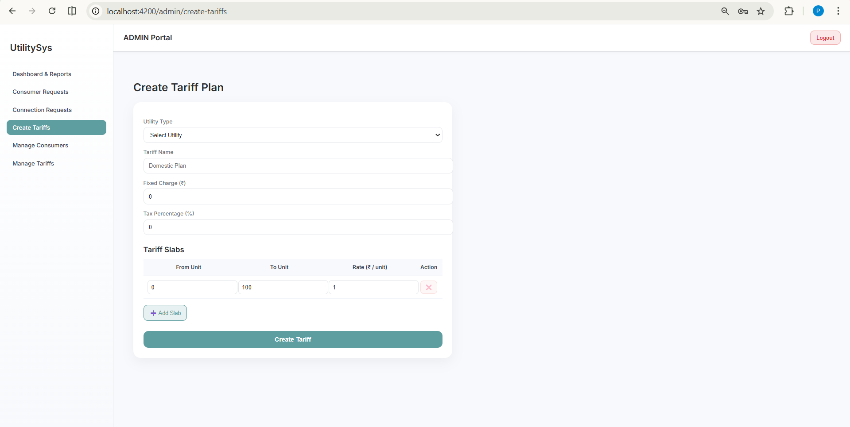
Create Tariffs by ADMIN

Slide 19
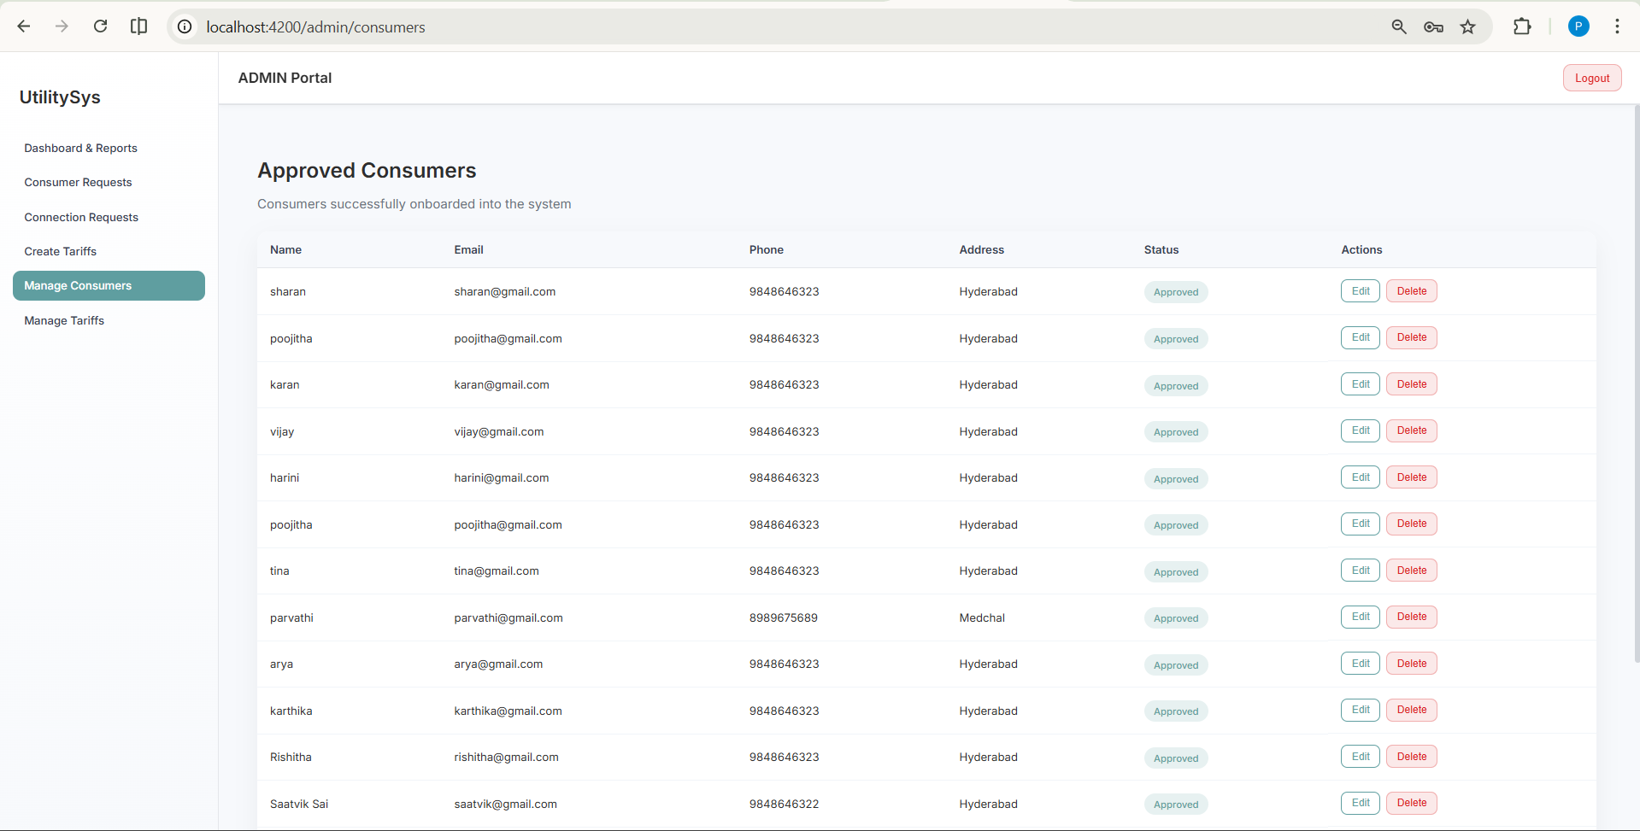
ADMIN Manage all Approved Consumers

Slide 20
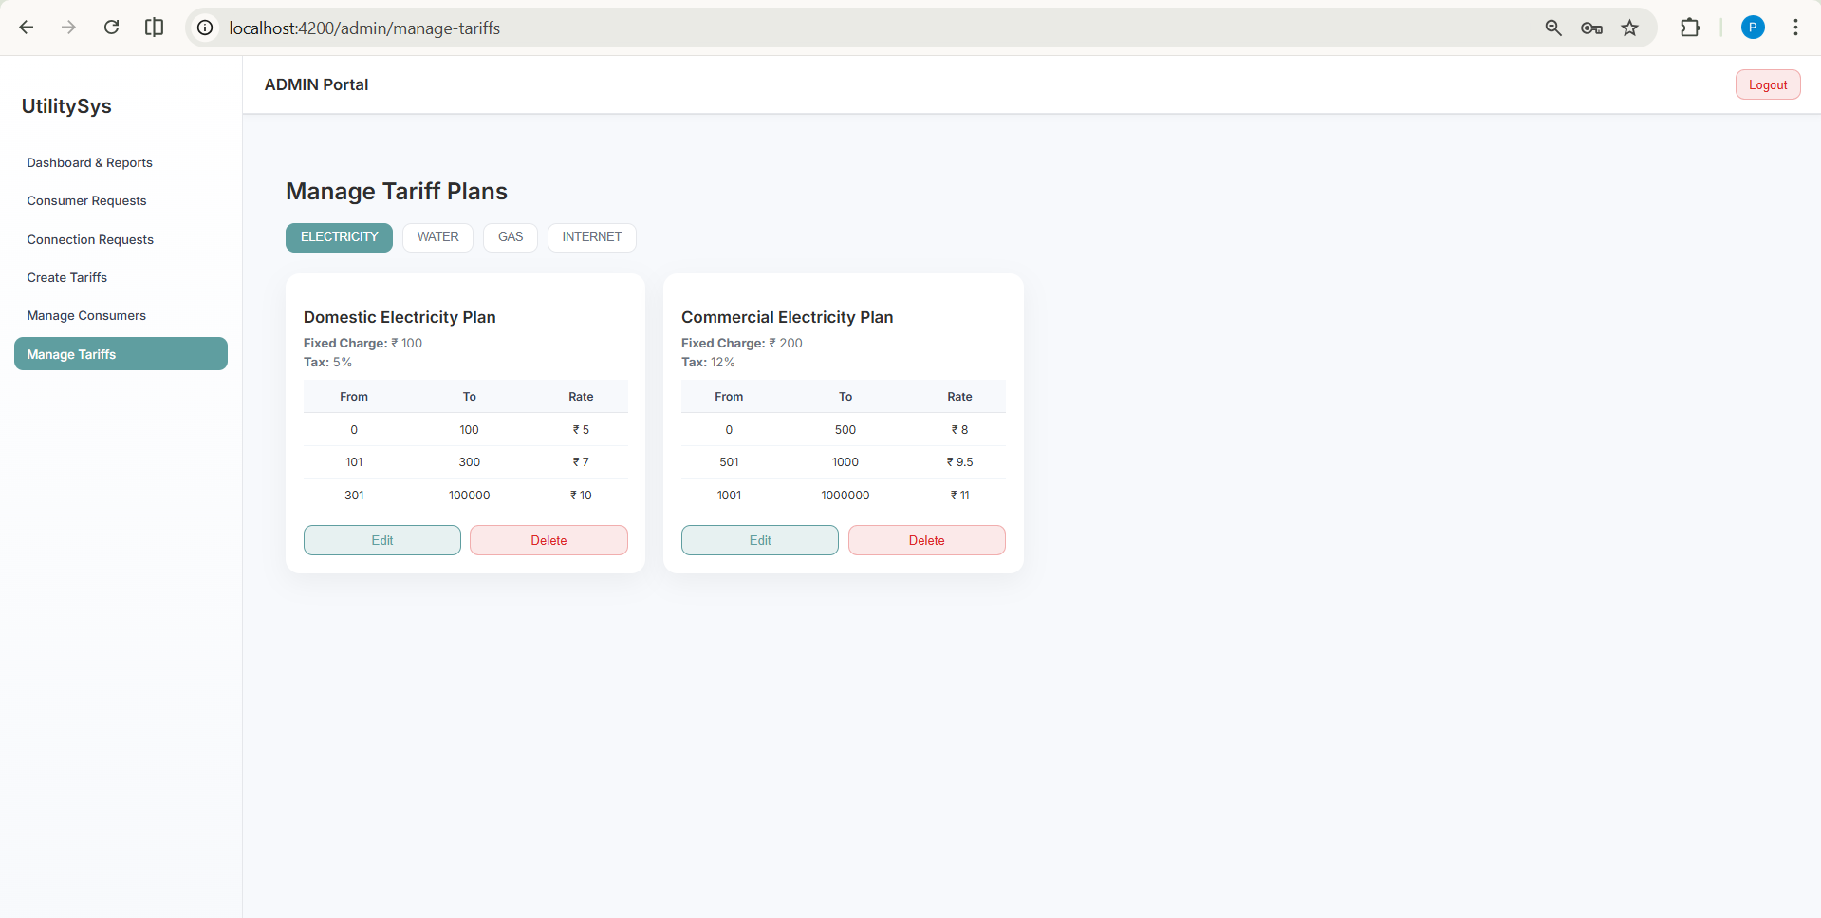
ADMIN manage all available Tariffs for all utilitites

Slide 21
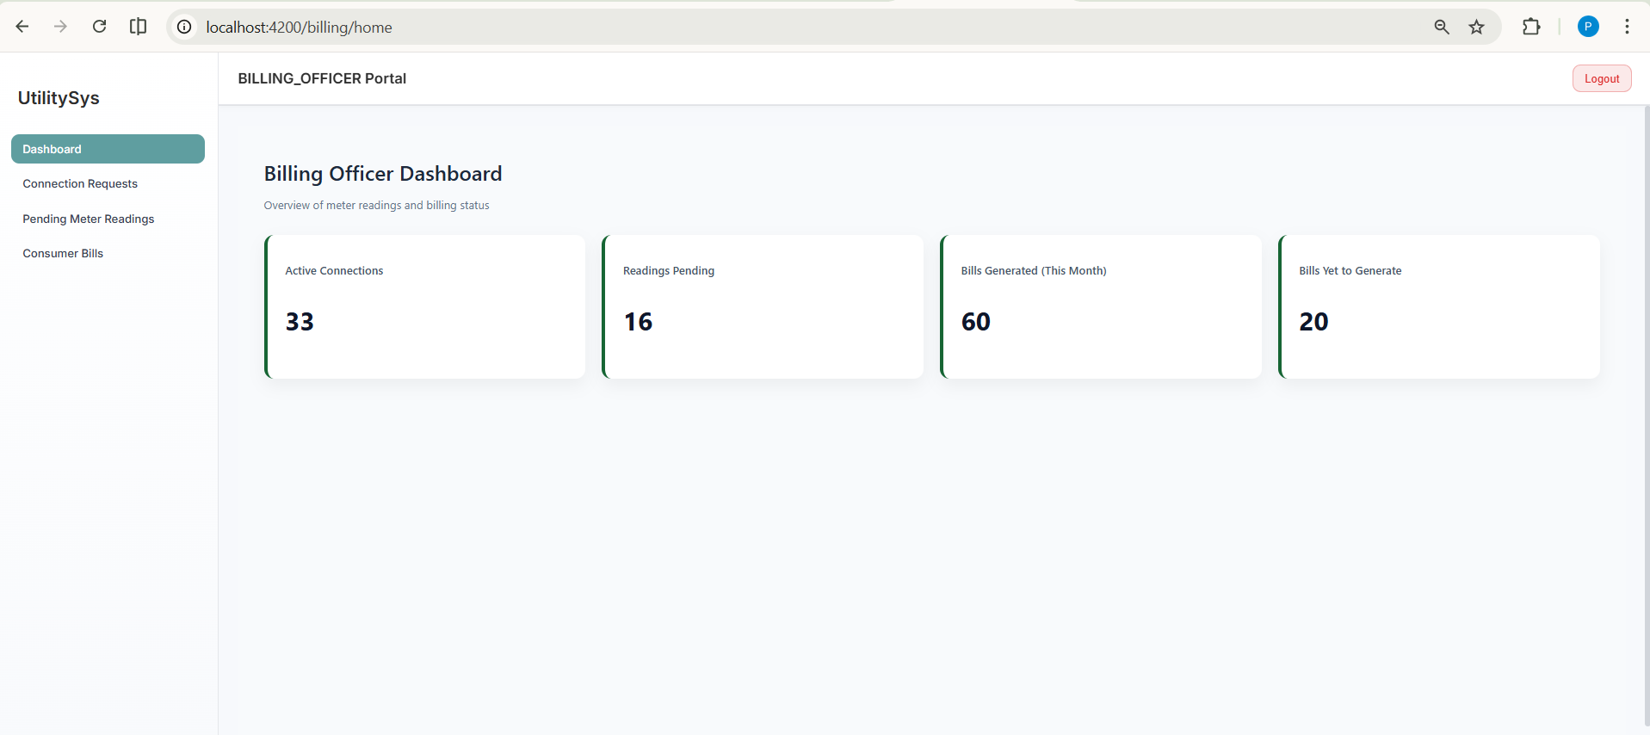
Billing Officer Home

Slide 22
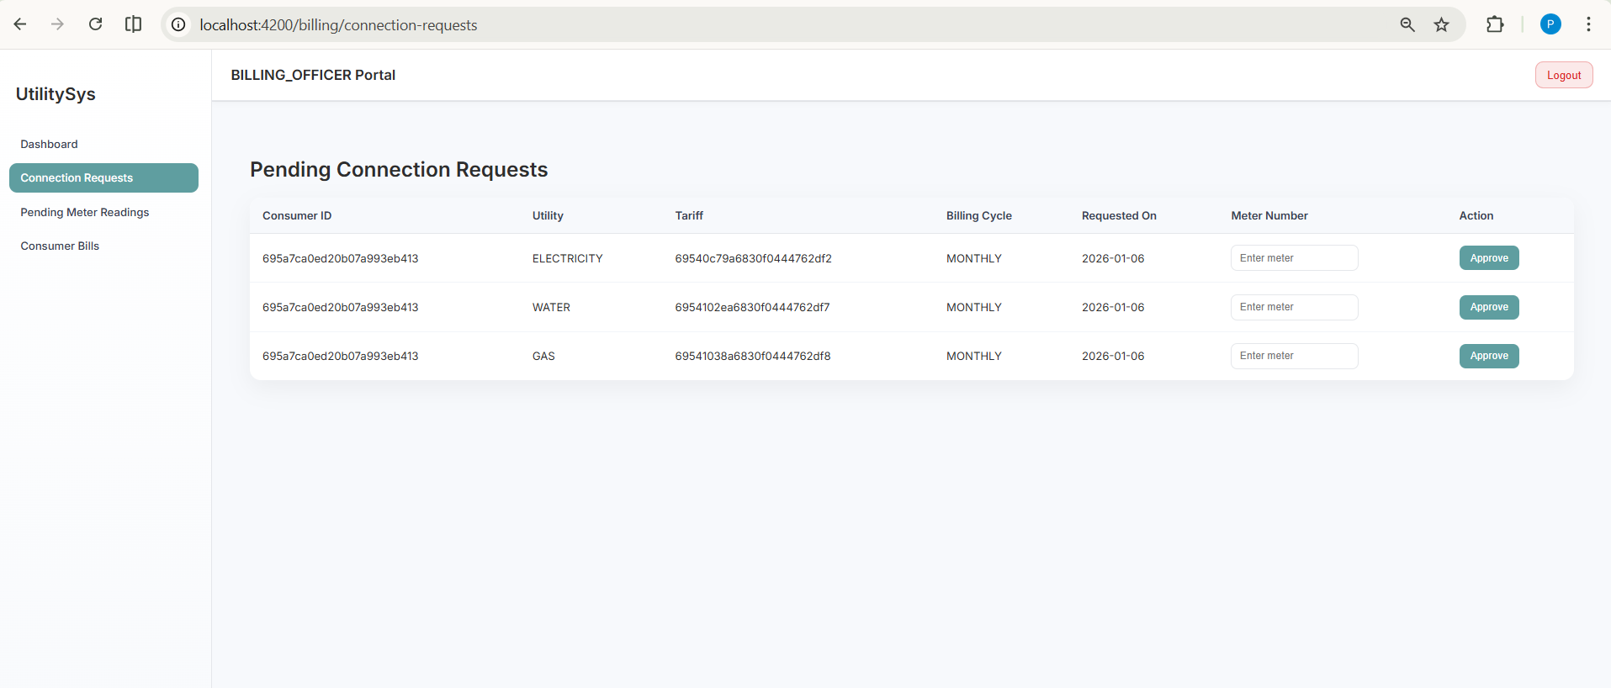
When consumer requests for connection, billing officer assigns a meter number and approves the connection.

Slide 23
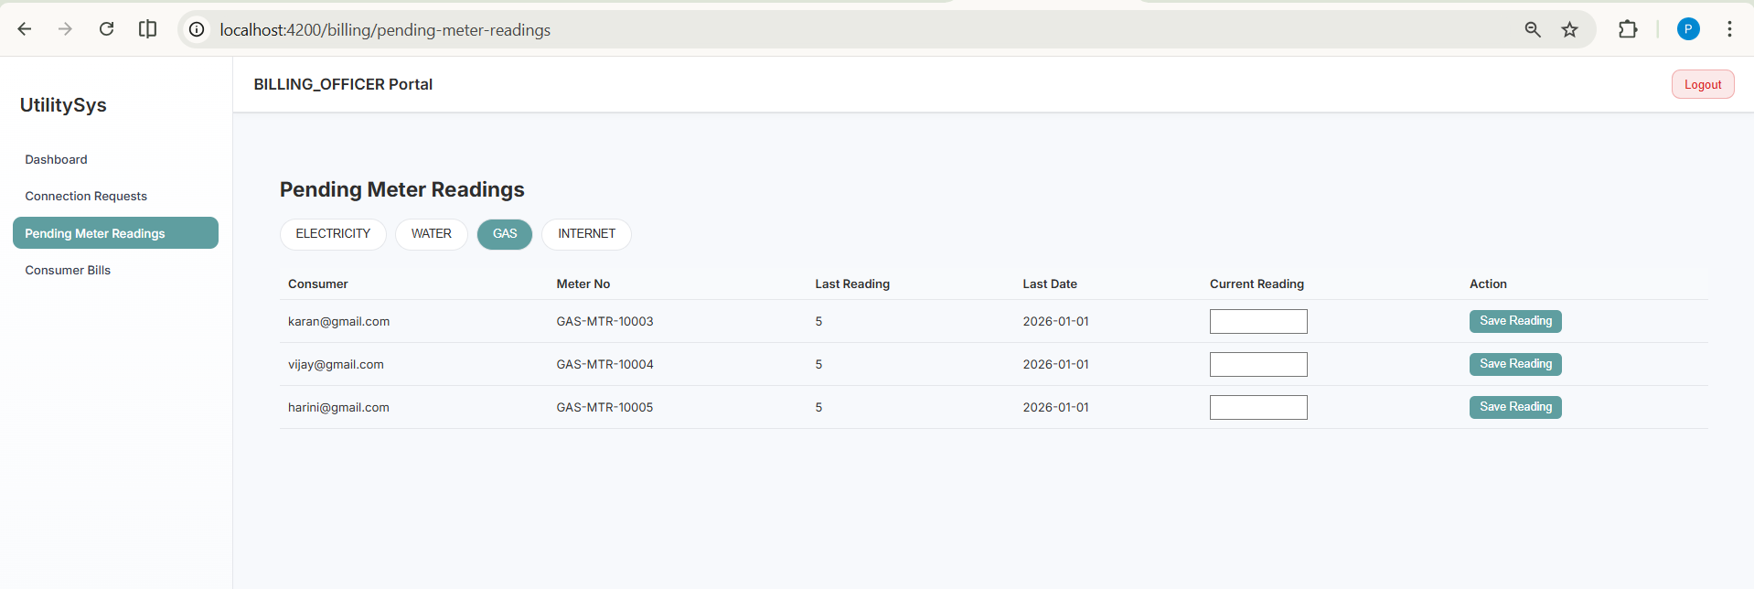
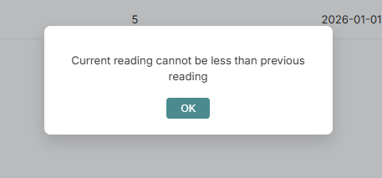
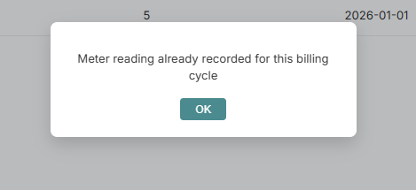
Billing officer every month gives meter readings to every connection
Some important validations

Slide 24
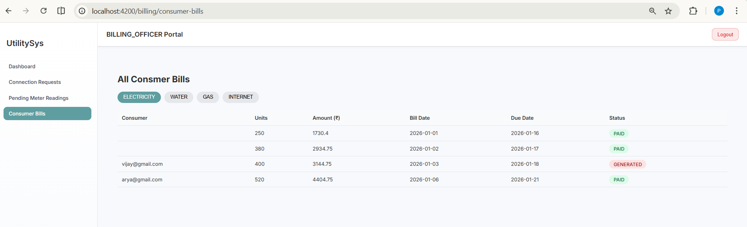
Consumer Bills are managed by Billing officer

Slide 25
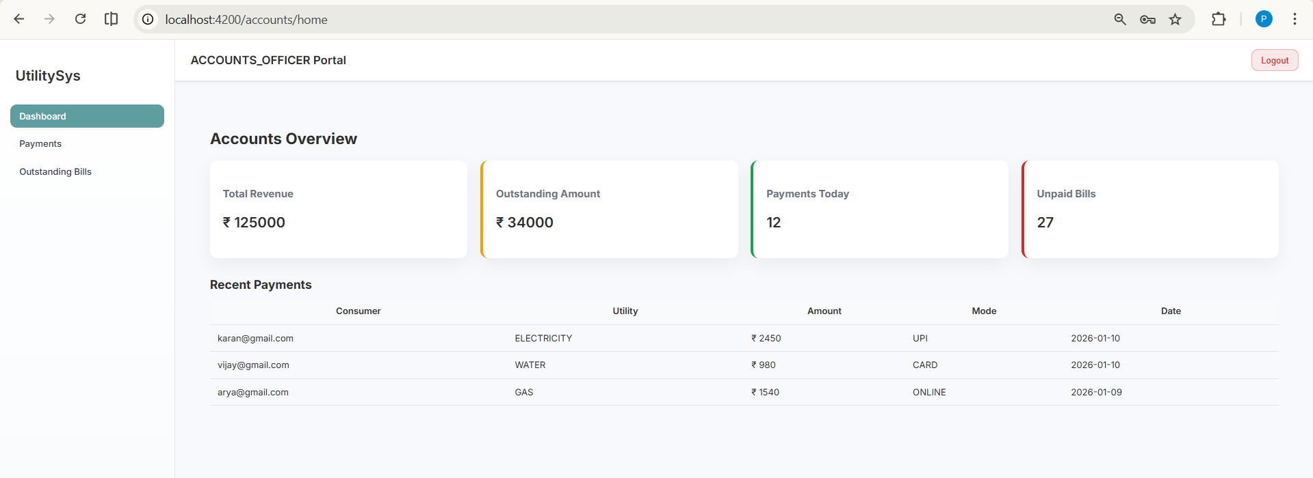
Accounts Officer Portal

Slide 26
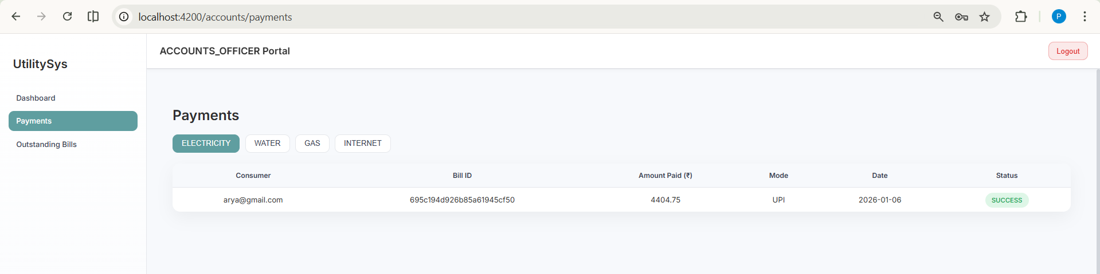
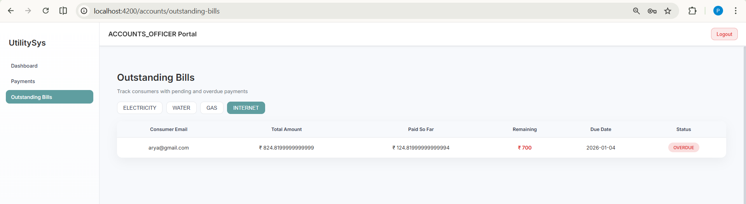
All the payments for each utility are shown
All the Outstanding Bills for each utility are shown

Slide 27
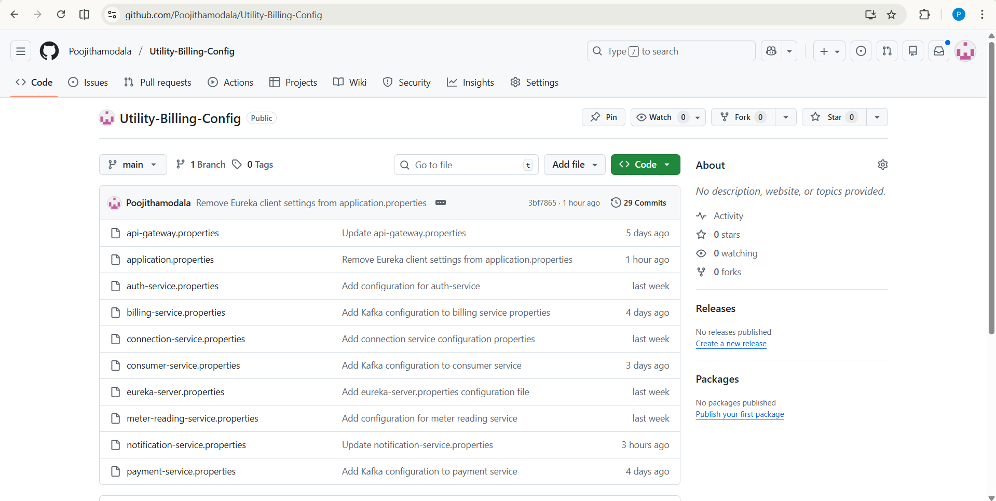
Config Repo
https://github.com/Poojithamodala/Utility-Billing-Config

Slide 28
ER Diagram
User – system login(Admin, Officers, Consumer)
Consumer – Own connections
Connection – linked to tariff plan
Meter Reading – generated for a connection
Bill – created from meter reading
Payment – clears bill amount

Slide 29
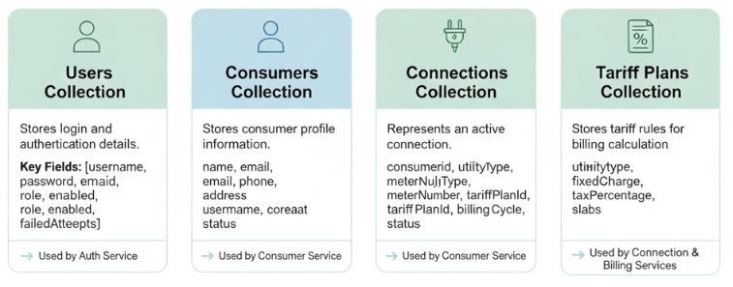
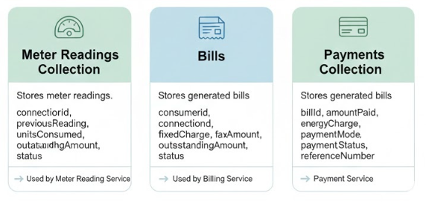
Database Design

Slide 30
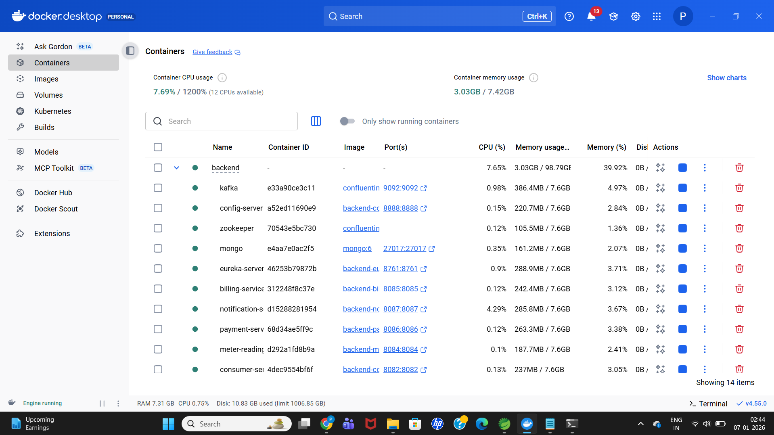
Dockerization

Slide 31
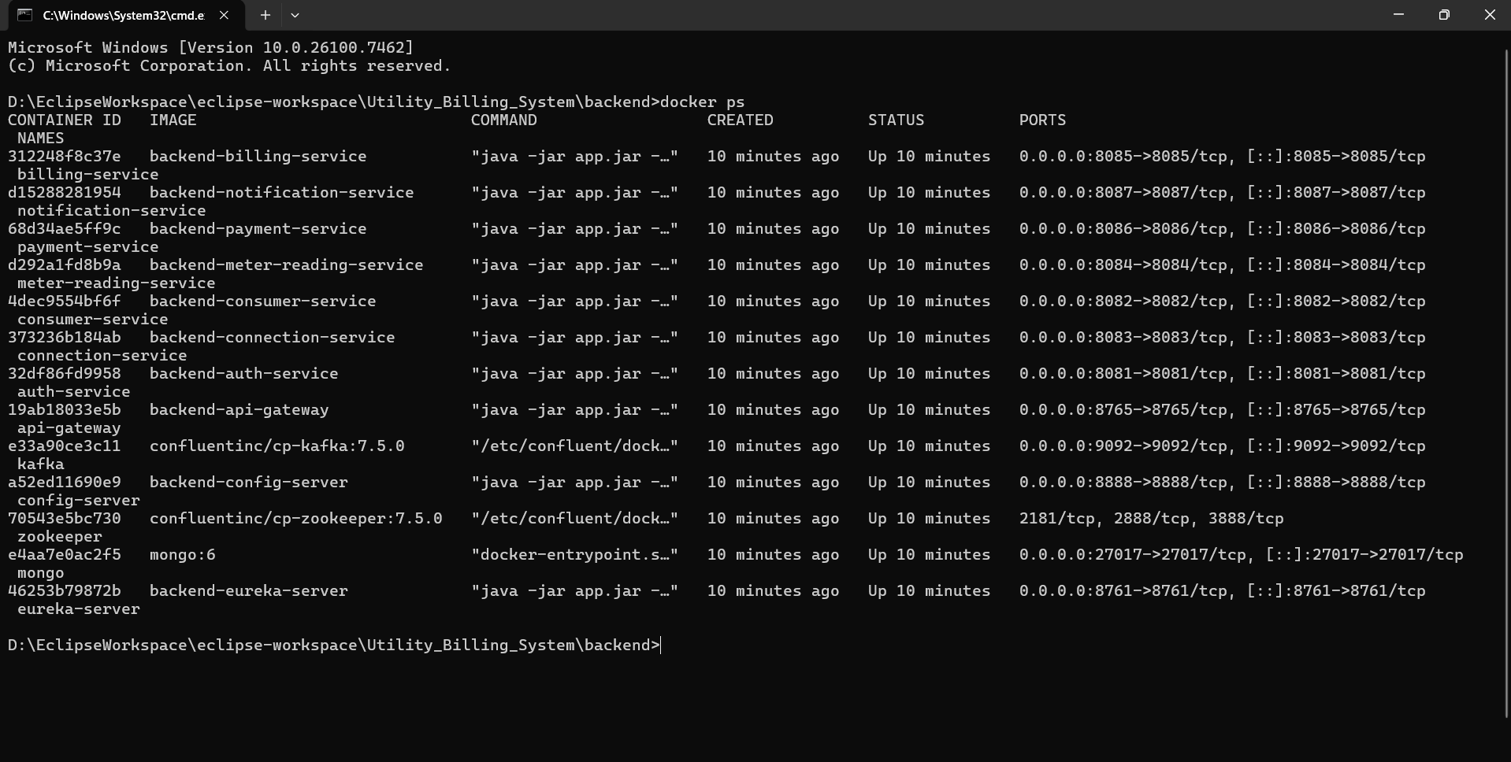
docker ps

